Slide 1






Nearest Neighbor Classifiers
Basic idea:
  If it walks like a duck, quacks like a duck, then it’s probably a duck
Compute Distance
Test Record
Training Records
Choose k of the “nearest” records
Data Mining: Concepts and Techniques

Slide 2
Nearest neighbor method
Majority vote within the k nearest neighbors
new
K= 1: blue
K= 3: green
Data Mining: Concepts and Techniques

Slide 3
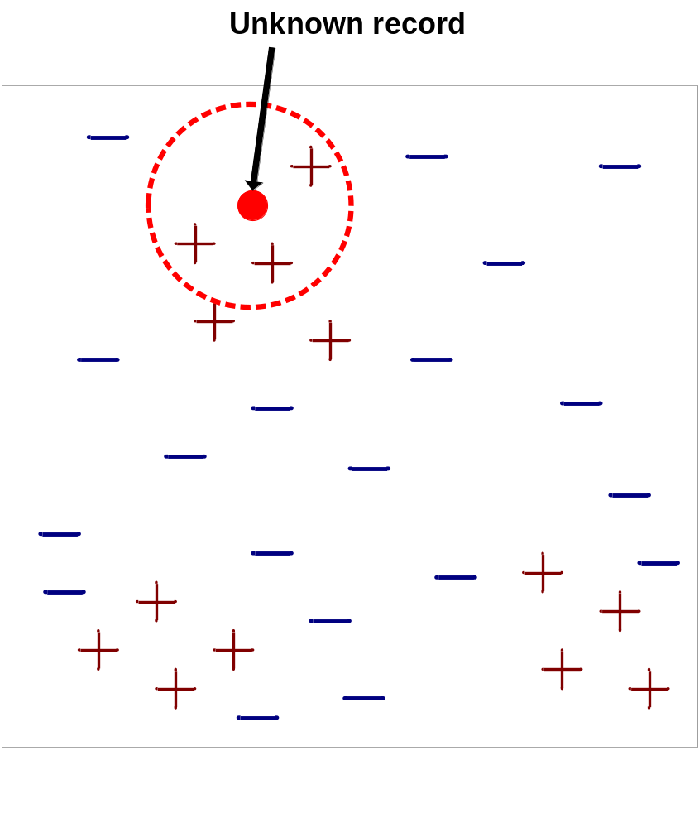
Nearest-Neighbor Classifiers
Requires three things
  The set of stored records
  Distance Metric to compute distance between records
  The value of k, the number of nearest neighbors to retrieve
To classify an unknown record:
  Compute distance to other training records
  Identify k nearest neighbors
  Use class labels of nearest neighbors to determine the class label of unknown record (e.g., by taking majority vote)
Data Mining: Concepts and Techniques

Slide 4

Definition of Nearest Neighbor
K-nearest neighbors of a record x are data points that have the k smallest distance to x
Data Mining: Concepts and Techniques

Slide 5
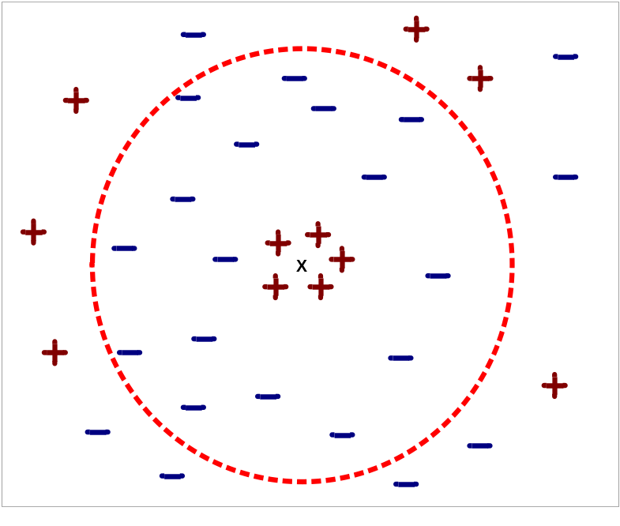
Nearest Neighbor Classification…
Choosing the value of k:
  If k is too small, sensitive to noise points
  If k is too large, neighborhood may include points from other classes
Data Mining: Concepts and Techniques

Slide 6
Nearest neighbor Classification…
k-NN classifiers are lazy learners
  It does not build models explicitly
  Unlike eager learners such as decision tree induction and rule-based systems
  Classifying unknown records are relatively expensive
Data Mining: Concepts and Techniques

Slide 7
Metrics for Performance Evaluation
Focus on the predictive capability of a model
  Rather than how fast it takes to classify or build models, scalability, etc.
Confusion Matrix:
 | PREDICTED CLASS
ACTUAL CLASS |  | Class=Yes | Class=No
 | Class=Yes | a | b
 | Class=No | c | d
a: TP (true positive)
b: FN (false negative)
c: FP (false positive)
d: TN (true negative)
Data Mining: Concepts and Techniques

Slide 8
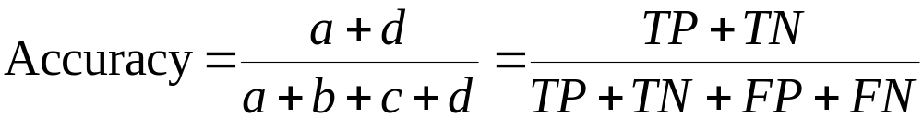
Metrics for Performance Evaluation…
 | PREDICTED CLASS
ACTUAL CLASS |  | Class=Yes | Class=No
 | Class=Yes | a (TP) | b (FN)
 | Class=No | c (FP) | d (TN)
Most widely-used metric:
Data Mining: Concepts and Techniques

Slide 9
Limitation of Accuracy
Consider a 2-class problem
  Number of Class 0 examples = 9990
  Number of Class 1 examples = 10
If model predicts everything to be class 0, accuracy is 9990/10000 = 99.9 %
  Accuracy is misleading because model does not detect any class 1 example
Data Mining: Concepts and Techniques

